Slide 1
Samiha Sarker Sweety .
Class Roll : 0941
Supervised by:
Prof. Dr. Mohammod Shoyaib .

Slide 2
Project: Human activity recognation from sensor data.

Slide 3
My Progress In Mid :
K-Nearest neighbors ( KNN )
Generic Method for any Dataset .
Naivebayes implement .
10 fold Cross vadidation .
Accuracy calculation .
Decision Tree ( only theory complete )
Precision,Recall,Fmeasure - For Binary Classification ( After Mid ).

Slide 4
K-Nearest Neighbors(KNN)
1.Handle Data:
Open the dataset from CSV and split into test/train dataset .
2.Similarity:
Calculate the distance between two data instances.
3.Neighbors:
Locate k most similar data distances
4.Response:
Generate a response from a set of data instances.
5.Accuracy:
Summarize the accuracy of predictions.
6.Main:
Tie it all together

Slide 5
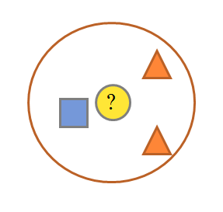
k NEAREST NEIGHBOR
Requires 3 things:
Feature Space(Training Data)
Distance metric
to compute distance between records
The value of k
the number of nearest neighbors to retrieve from which to get majority class

Slide 6
k NEAREST NEIGHBOR
To classify an unknown record:
Compute distance to other training records
Identify k nearest neighbors
Use class labels of nearest neighbors to determine the class label of unknown record

Slide 7
k NEAREST NEIGHBOR
Common Distance Metrics:
Euclidean distance(continuos distribution)
d(p,q) = √∑(p_{i} – q_{i})²

Slide 8
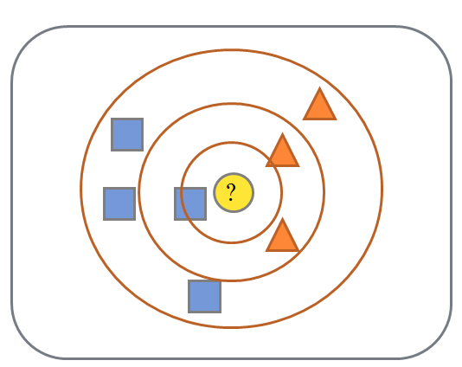
k NEAREST NEIGHBOR
k = 1:
Belongs to square class
k = 3:
Belongs to triangle class
k = 7:
Belongs to square class
Choosing the value of k:
If k is too small, sensitive to noise points
If k is too large, neighborhood may include points from other classes
Choose an odd value for k, to eliminate ties

Slide 9
Bubble sort

Slide 10
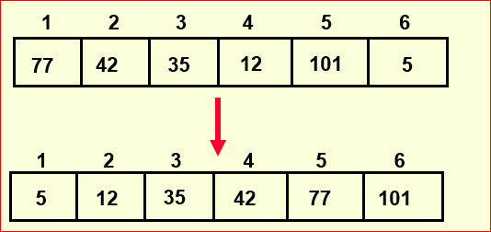
Sorting
Sorting takes an unordered collection and makes it an ordered one.

Slide 11
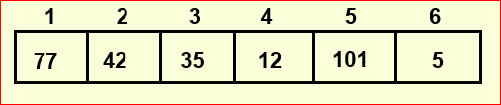
“Bubbling Up” the Largest Element
Traverse a collection of elements
Move from the front to the end
“Bubble” the largest value to the end using pair-wise comparisons and swapping

Slide 12
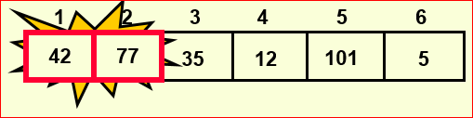
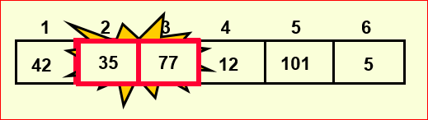
“Bubbling Up” the Largest Traverse a collection of elements Move from the front to the end “Bubble” the largest value to the end using pair-wise comparisons and swapping

Slide 13
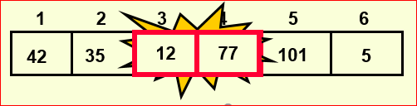
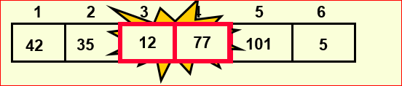
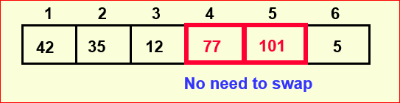
“Bubbling Up” the Largest Element
Traverse a collection of elements Move from the front to the end “Bubble” the largest value to the end using pair-wise comparisons and swapping

Slide 14
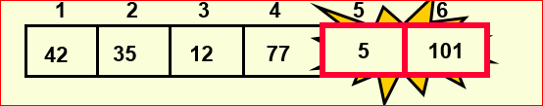
“Bubbling Up” the Largest Element
Traverse a collection of elements Move from the front to the end “Bubble” the largest value to the end using pair-wise comparisons and swapping

Slide 15
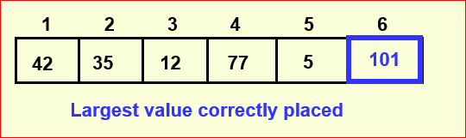
“Bubbling Up” the Largest Element
Traverse a collection of elements Move from the front to the end “Bubble” the largest value to the end using pair-wise comparisons and swapping

Slide 16
Repeat “Bubble Up” How Many Times?
If we have N elements…
And if each time we bubble an element, we place it in its correct location…
Then we repeat the “bubble up” process N – 1 times.
This guarantees we’ll correctly place all N elements

Slide 17
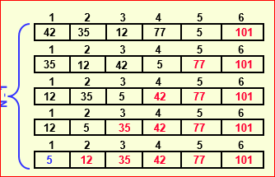
“Bubbling” All the Elements

Slide 18
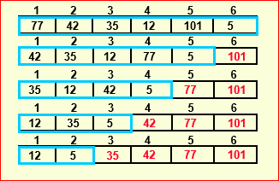
Reducing the Number of Comparisons

Slide 19
Bayes’ Theorem
P(A|B) = probability of A given that B is true.
P(A|B) = P(B|A)P(A)/P(B)
In practice we are most interested in dealing with events e and data D.
e = “I have a cold”
D = “runny nose,” “watery eyes,” “coughing”
P(e|D)=P(D|e)P(e)/P(D)
So Bayes’ theorem is “diagnostic”.

Slide 20
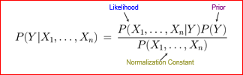
The Bayes Classifier
Use Bayes Rule!
Why did this help? Well, we think that we might be able to specify how features are “generated” by the class label

Slide 21
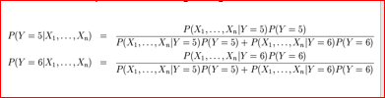
The Bayes Classifier
Let’s expand this for our digit recognition task:
To classify, we’ll simply compute these two probabilities and predict based on which one is greater

Slide 22
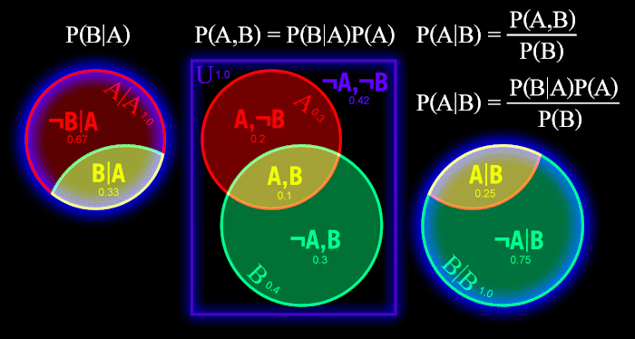
Bayes’ Theorem

Slide 23
Decision tree

Slide 24
Decision tree
Decision tree is a classifier in the form of a tree structure
Decision node: specifies a test on a single attribute
Leaf node: indicates the value of the target attribute
Arc/edge: split of one attribute
Path: a disjunction of test to make the final decision

Slide 25
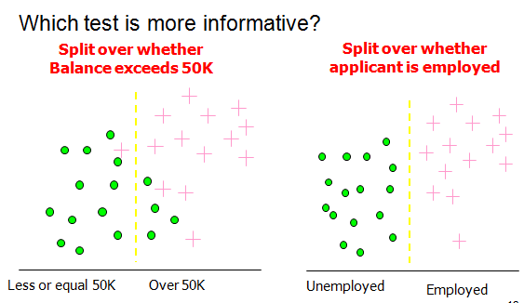
Information Gain

Slide 26
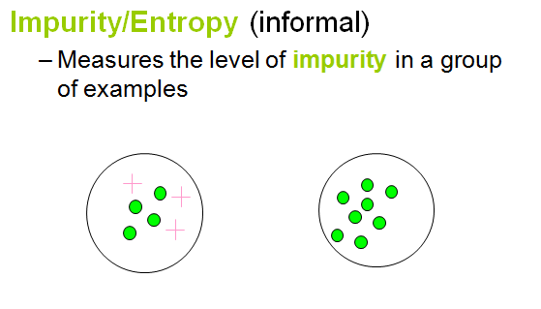
Information Gain

Slide 27
Information Gain
We want to determine which attribute in a given set of training feature vectors is most useful for discriminating between the classes to be learned.
Information gain tells us how important a given attribute of the feature vectors is.
We will use it to decide the ordering of attributes in the nodes of a decision tree.

Slide 28
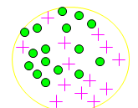

Entropy
Entropy =
p_{i} is the probability of class i
Compute it as the proportion of class i in the set.
Entropy comes from information theory. The higher the entropy the more the information content.

Slide 29
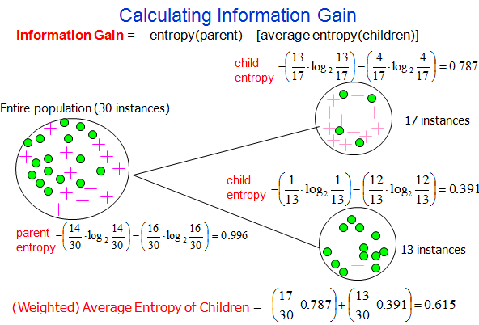
Information Gain= 0.996 - 0.615 = 0.38
Information Gain= 0.996 - 0.615 = 0.38

Slide 30
Cross-Validation

Slide 31
Cross-Validation Performance of a Learning Algorithm
Samples from X are typically unavailable
Take out some of the training set
Train on the remaining training set
Test on the excluded instances
Cross-validation

Slide 32
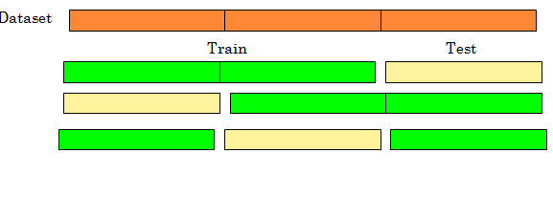
Cross Validation Common Splitting Strategies
k-fold cross-validation

Slide 33
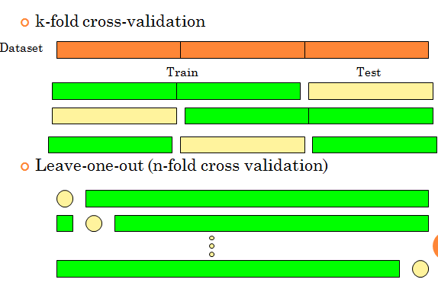
Cross Validation
Common Splitting Strategies

Slide 34
Cross Validation Computational complexity
k-fold cross validation requires
k training steps on n(k-1)/k datapoints
k testing steps on n/k datapoints
(There are efficient ways of computing L.O.O. estimates for some nonparametric techniques, e.g. Nearest Neighbors)
Average results reported

Slide 35
Accuracy , Precision And Recall

Slide 36
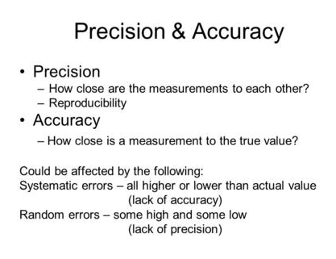

Slide 37
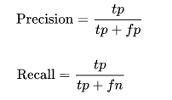

Accuracy , Precision And Recall
Positively-labeled means judged “relevant” by the search engine or labeled as in the class by a classifier.
tp = true positive, fp = false positive etc.

Slide 38
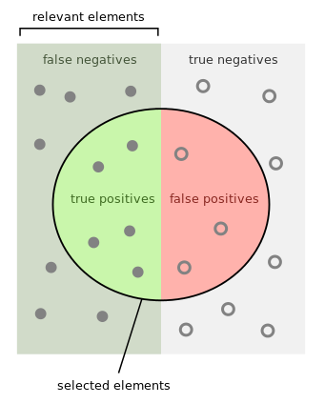
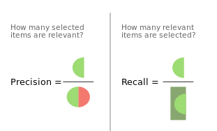
Precision and Recall

Slide 39
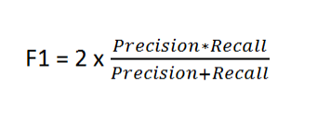
F-Measure
A measure that combines precision and recall is the harmonic mean of precision and recall.

Slide 40
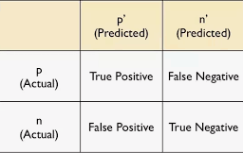
F-Measure
This is related to the field of binary classification where recall is often termed as Sensitivity.

Slide 41
Github link
https://github.com/samihasarker/SPL-1-../blob/master/10cross.py
https://github.com/samihasarker/SPL-1-../blob/master/iris.csv
https://github.com/samihasarker/SPL-1-../blob/master/wine.csv

Slide 42
THANK YOU

